Slide 1

Project on LONG RANGE SPY ROBOT WITH NIGHT VISION
By
POOSA MANASA (23U65A0401)
BUJENGARI SANEETH REDDY (22U61A0403)
AMBATI PRANAY KUMAR (22U61A0401)
SHAIK RAMIDHA (22U61A0411)
Under the Guidance of
Mr. Md Altaf Ur Rahman
B.E(OU); M.E(OU)
Assistant Professor, Dept. of ECE

Slide 2
Outline
Abstract
Block Diagram
Output
Advantages
Disadvantages
Applications
Future scope

Slide 3
Abstract
This project presents a long-range spy robot that can be controlled wirelessly from a distance to monitor remote or dangerous areas. The robot is equipped with a camera that provides live video streaming, allowing the user to see real-time surroundings. It also includes night vision capability, which helps the robot operate effectively even in low-light or dark conditions. The robot can move in different directions using motors and is designed to reduce human involvement in risky situations. This system can be used for security, surveillance, and rescue operations, making monitoring safer and more efficient.

Slide 4
Block Diagram
Hardware Block Diagram
ULTRASONIC SENSOR
(Obstacle detection)
WIRELESS COMMUNICATION (WIFI/BLUETOOTH)
POWER SUPPLY
MICROCONTROLLER (ESP32)
CONTROL STATION
(PC/MOBILE)
MOTOR DRIVER
MODULE
(L298N)
DC MOTORS
(Wheels for movement)

Slide 5
1.Power Supply
Can be a battery or adapter
Provides stable voltage to avoid damage
2.Ultrasonic Sensor
Helps in collision avoidance
Improves safety during movement.
3.Microcontroller (ESP32)
Has built-in Wi-Fi and Bluetooth
Fast processing and low power consumption

Slide 6
4.Wireless Communication
Works over a long distance
Enables real-time control and monitoring
5.Control Station (PC/Mobile)
User-friendly interface for easy operation
Can be used from a safe remote location
6.Motor Driver Module (L298N)
Protects microcontroller from high current
Allows control of multiple motors

Slide 7
7.DC Motors
Provide required speed and torque
Ensure smooth and flexible movement
8.Night Vision Camera
Captures video in low light or darkness
Sends live video feed to the user
Useful for night surveillance

Slide 8
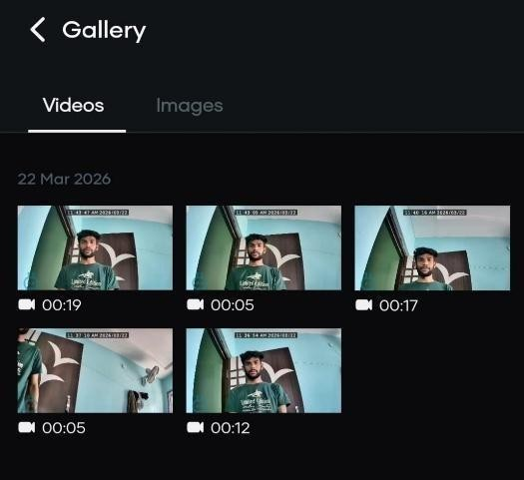
Output
Video sample from camera module in day time

Slide 9
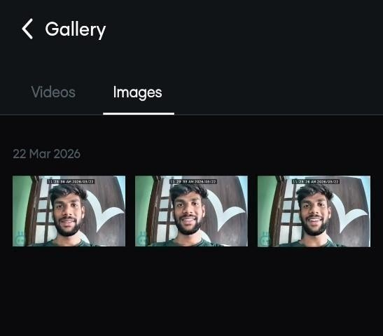
Output
Image samples from camera module in day time

Slide 10
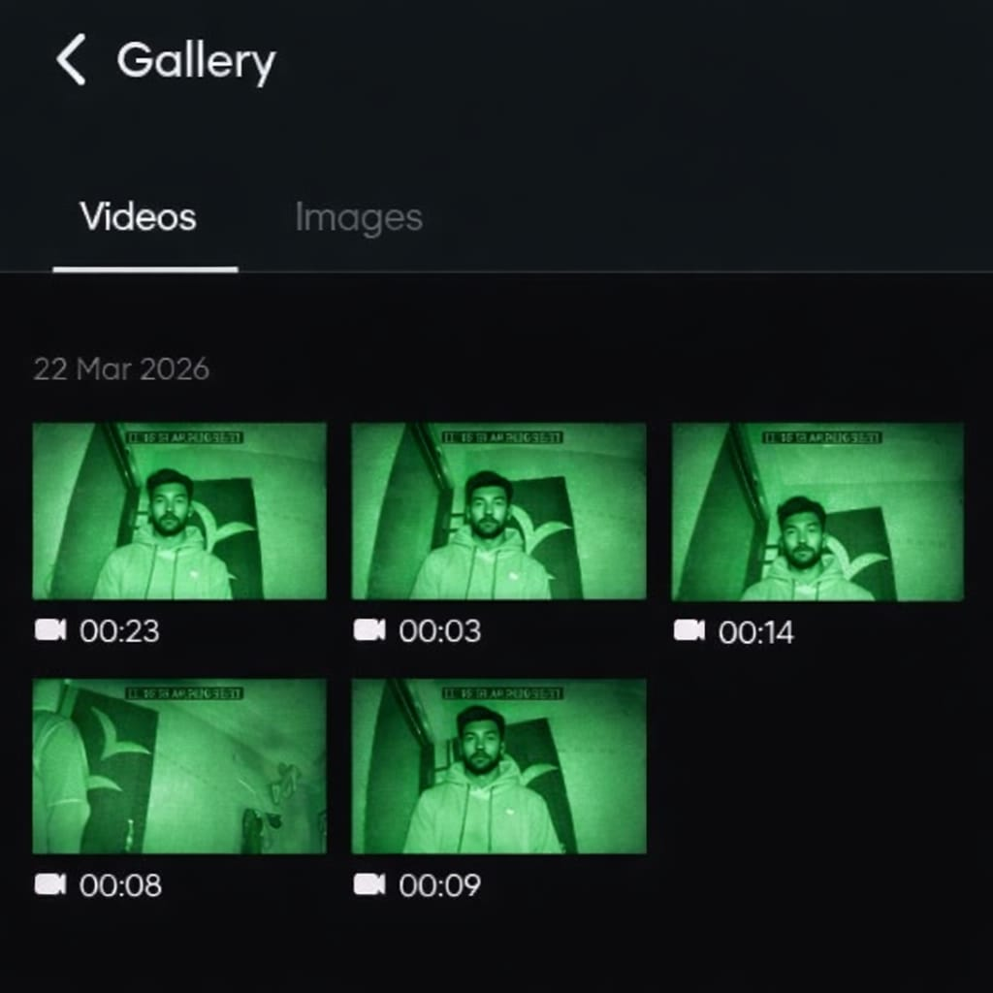
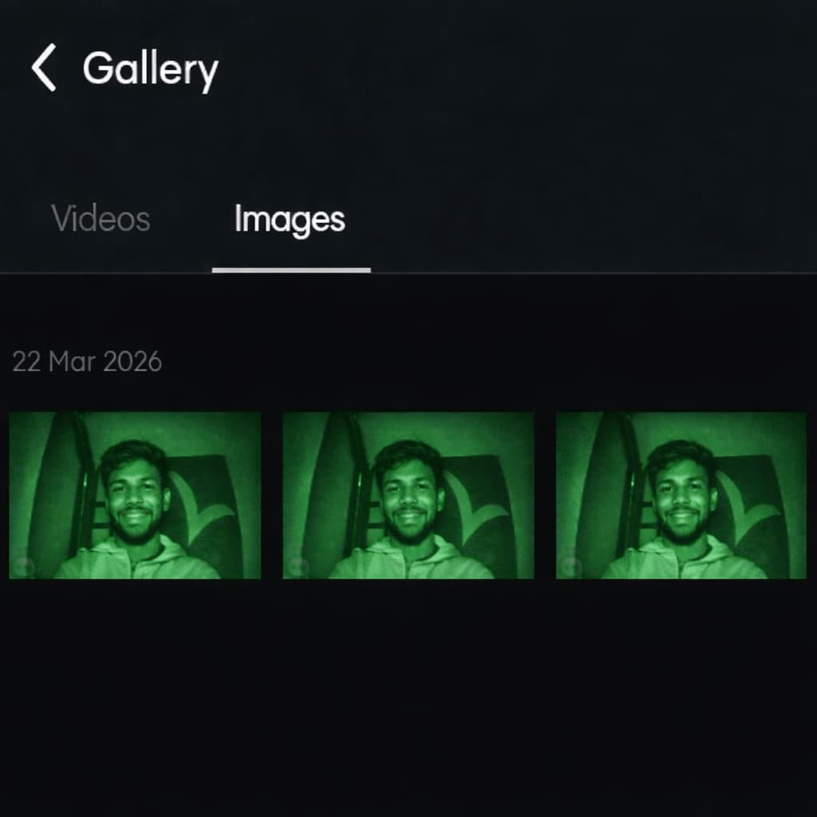
Output
Video and image samples from camera module in night time

Slide 11
Advantages
Can be controlled from a long distance
Works in dark and low-light conditions
Reduces risk to human life in dangerous areas
Provides real-time video monitoring
Useful for security and surveillance
Can detect obstacles and avoid collisions
Easy to operate using mobile or PC

Slide 12
Disadvantages
Limited battery life
Signal range can be affected
May not work well in rough terrain
Requires stable internet/Wi-Fi
Limited load-carrying capacity

Slide 13
Applications
Used for security and surveillance
Helps in military operations
Useful in border monitoring
Used in rescue operations
Helps in disaster management
Used in spying and investigation
Useful in industrial inspection

Slide 14
Future scope
Better camera quality for clearer video monitoring
Longer battery life for extended operation time
Increased control range for long-distance use
Improved night vision for better visibility in darkness
Easy mobile control through user-friendly apps
Stronger body design for rough environments
Real-time alerts for danger or movement

Slide 15
THANK YOU

